Slide 1
Study the Impact of EVs
on
Indian Economy
Under Guidance of : Dr. Arnab Bhattacharya
Course : Data Mining (CS685A)
Group Name : G-5
Group Members : Ankit Raja 21111012 ankitr21@iitk.ac.in
Neeraj Chouhan 21111044 neerajch21@iitk.ac.in
Sahil Shukla 21111054 sahils21@iitk.ac.in
Ayush Singh 21111020 ayushs21@iitk.ac.in
Ayush Sahni 21111019 sayush21@iitk.ac.in

Slide 2
Introduction:
Our country India invests its large amount of capital into import of crude oil and natural gas and this is around 32% of total import done by India.
To reduce our dependence on crude oil and natural gases, Electric Vehicle is the way forward to bring out a revolution in the transport sector of India and boost up the economy.
So we would like to study the impact of electric vehicles on Indian economy and few other aspects of electric vehicles in India by year 2030.

Slide 3
Data Sets Used:
We have used four different type of data sets.
Vehicle Dataset
Electricity consumed by EVs
Electricity prices in India
Oil Data(Oil import and Oil Price)

Slide 4
Workflow :
Analysis of EV Sales by 2030
Study the Impact of EVs on Oil prices and Oil imports
Study the impact of EVs on future petrol prices
Prediction of EVs future market share and study its impact on Indian power sector
Study the monetary impact of EVs on Indian Economy
Study the impact of EVs on reduction in CO2 emission

Slide 5
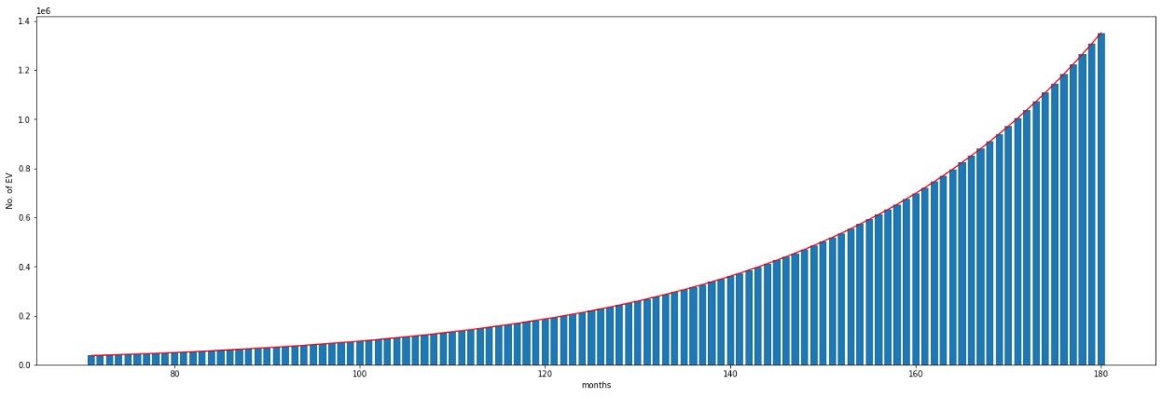
1. Analysis EV sales by Year 2030:
We have used previous data of number of EV year-wise from year 2016 to 2021.
Then we have used Linear Regression to predict the EV sales from 2022 – 2030.
As per our analysis there will be around 4 crore EV’s by 2030.
Here is the estimated number of EVs month-wise from 2022 - 2030:

Slide 6
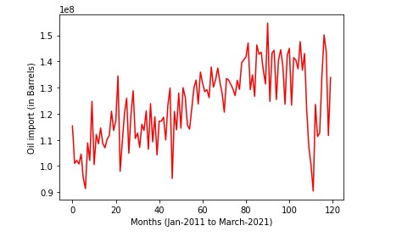
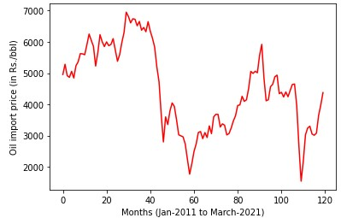
2. Study the Impact of EVs on Oil prices and Oil import:
Used oil data to extract oil import & oil import price from year 2011 – 2021 as shown below
Train ML model to predict the oil import price given oil import .

Slide 7
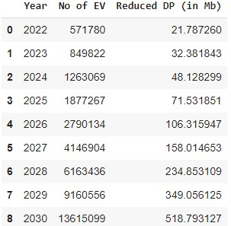
Analysis :
From EV Analysis we get how much oil consumption will be reduced in future years and using which we have estimated the resultant oil need of our transport sector. Since Transport sector has share of 70% of total oil import so we have changed this consumption share to oil import share.

Slide 8
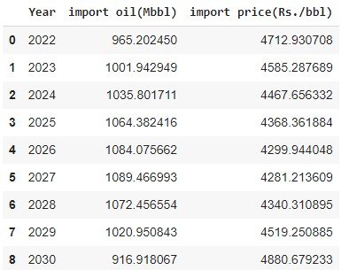
Result:
This oil import data has been treated as input for our model and predicted the oil import price for future years.

Slide 9
3. Study the Impact of EVs on Oil selling price and Oil import price:
We have changed the month-wise data of oil import price in year-wise form for analysis against the oil selling price in India.
After preprocessing the data, we have obtained the Oil selling price data(Rs.) and Oil import price(Rs./bbl) data over the years. We have used a Linear Regression model to train Oil selling price data given the Oil import price data.
In this model we take input from previous analysis of oil import price for future years and predict the oil selling price in indian market.

Slide 10
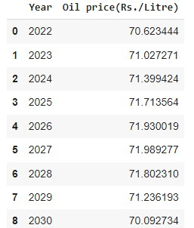
Result:
i

Slide 11
Analysis:
There is no co-relation b/w oil import price and oil selling price in India, number of factors responsible for influencing petroleum prices other than cost of crude oil like- demand and supply imbalances, taxes and duties on petroleum products and market conditions, production and consumption of petroleum products, petroleum reserves, imports of petroleum products, international prices of petroleum products,subsidy on petroleum products, and locational effects, etc.

Slide 12
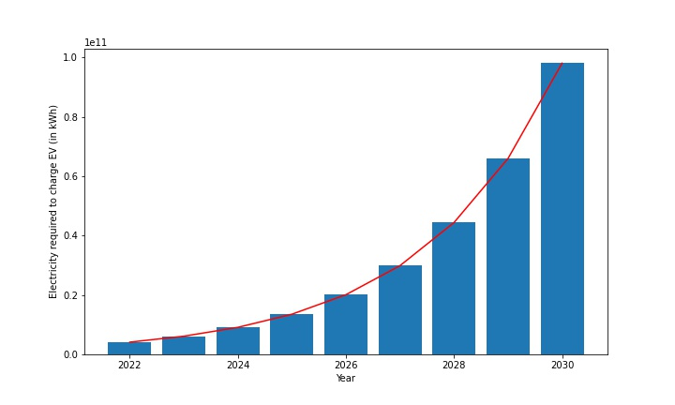
4. Predict EVs future market share and study its impact on Indian power sector
Used daily charging demand by EV from ”Electricity consumed by EVs” datafile.
Calculated Electricity required to charge EVs from 2022 - 2030 using below formula
Electricity required = Number of EV ∗ Average electricity required to charge one EV yearly
In the year 2030 India will require 9.8 × 10 kWh of electricity to charge EVs

Slide 13
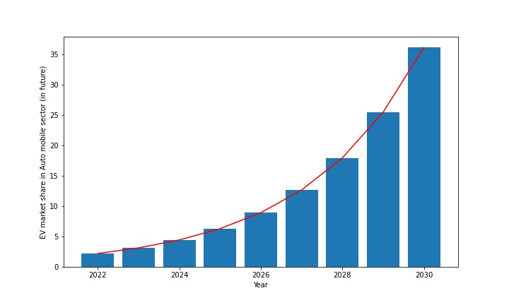
4. Predict EVs future market share and study its impact on Indian power sector
Used total vehicles sale data from year 2016 – 2021.
Applied Linear Regression to predict total vehicle sales from 2022 – 2030.
Calculated EVs market share in future using number of EV and total vehicle sales from 2022 to 2030.
Estimated EV market share(percentage) month-wise from 2022 - 2030 shown below

Slide 14
5. Study the monetary impact of EVs on Indian Economy
How EV impact the indian economy?
The overall Idea is importing less Oil from Foriegn countries because of promoting more EVs helps in improvement of indian economy.
How we are saving Oil import expenditure when EVs are introduced ?
Linear Regression model on the electricity cost(Rs./kWh) data of the past years to predict the cost of electricity in Rs./kWh for the upcoming years.
We have known the amount of electricity required(in kWh), Thus we can calculate the overall electricity cost(in Cr) as
Electricity required(kWh) x Electricity cost(Rs./kWh) x 10000000

Slide 15
5. Study the monetary impact of EVs on Indian Economy
We have known the Oil consumption reduced(in Mb) and predicted Oil import price(Rs./bbl) for the upcoming years. Hence the Amount(in Cr) saved because of not import the excess Oil as -
Reduced Oil consumption(Mb) x Predicted Oil Import Price(Rs./bbl)
We can calculate the Effective amount saved by subtracting the result from electricity cost(in Cr) from Amount(in Cr) saved because of not import the excess Oil.

Slide 16
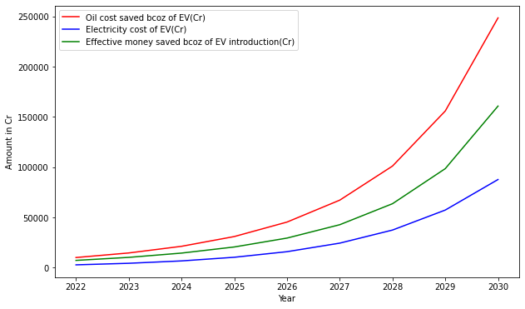
5. Study the monetary impact of EVs on Indian Economy
The increasing sales of EV will save worth INR 4.5 lakh crore by 2030.

Slide 17

6. Study the impact of EVs on reduction in CO2 emission
From the government sources we found out that a typical oil-fuel based vehicle emits about 4.6 metric tons of CO2 per year.
To calculate reduction in CO2 emission year wise we used following formula.
Reduction in CO2 emission(Metric ton) = Number of EV × 4.6

Slide 18
Disadvantage of EVs
The battery used in EVs is mostly Lithium-ion based. One electric car battery contains approx. 10Kg lithium. Most of the world's lithium is extracted from a mineral-rich brine in which earth is drilled and brine is pumped out to surface where it is left for several months to evaporate.
This process consumes a huge amount of water which could have otherwise used by local farmers. Nearly 2 million liters of water is consumed to produce 1 ton of lithium.
The extraction also requires vast area of land where evaporation takes place which could have been used by the wildlife.
We must find other way of lithium extraction which are more eco friendly.

Slide 19
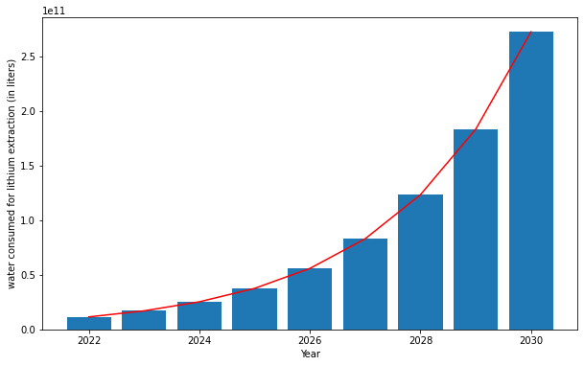
Disadvantage of EVs
The graph shows water consumption in liters for the production of lithium from 2022-2030. The amount of water consumed is directly proportional to number of EVs.

Slide 20
THANK YOU…
Any Questions ???

